Slide 1
Update on Nutanix
June 22, 2017

Slide 2
Agenda
Review facts about Nutanix
Discuss architecture
Discuss progress
Talk about upcoming announcements at .NEXT
Next steps

Slide 3
Nutanix Facts
Founded in 2009 by those involved with design of the Google File System
Idea was to create a web-scale environment for on-premises corporate infrastructures
Make IT as easy to deploy and use as an iPhone
Started shipping products in 2011
Software company, but initial deployments have been as an appliance
Company is in hyper-growth mode
Leader in both Gartner and IDC ratings for converged infrastructure
This is an experienced, well run, innovative company

Slide 4
More Nutanix Facts
Revenue in 2016 was over $440 million
IPO was September 2016; stock up 12% since IPO
Expected revenue of over $800 million for YE’17 (July ‘17)
Over 6,600 customers
Over 2,500 employees
Ships to over 150 countries
Net Promoter Score is 90

Slide 5
Level Set-Traditional 3-Tier Architecture
Separate and discrete servers, storage, and networking
Operating systems tend to go with device
Hypervisor is a separate product
Purchased with eye toward 3-5 year horizon
Product cost, support cost
Interoperability
Industry standard servers use Intel chips (some AMD)
All storage arrays use Western Digital or Seagate disk drives, with SSD drives becoming the standard
Physical controllers connect all of the devices

Slide 6
Level Set-Traditional 3-Tier Architecture
Need talent to manage all of the devices and software, usually specialized people
Probably have fewer people in the team than you could use
Downward pressure on costs for IT
Constant inquiry/pressure about using “The Cloud” instead of your own infrastructure
At the mercy of the manufacturers for advancement
Still very much a hardware-based approach to IT
Vendors do not innovate at the same rate, resulting in unbalanced systems
Users are dependent on increments decided by the Vendor, not by use case

Slide 7
Basics of True Hyper-Converged Infrastructure
Software approach to the data center; commodity hardware is fine
Requires a web-scale file system at the core
Not just “combining disparate products” into one rack or appliance
Hardware stack is integrated with hypervisor and management stack
Allows users a Cloud environment in your own data center
And, it should be about giving you choice

Slide 8



Scalable Distributed System Design
Node 1
Node 2
Node N
VM
VM
VM
CVM
VM
VM
VM
CVM
VM
VM
VM
CVM
Hypervisor
Hypervisor
Hypervisor
X86
X86
X86
Distributed Storage Fabric
Snapshots
Clones
Compression
Deduplication
Locality
Tiering
Erasure Coding
Resilience
Notes:
Let’s take a look at the Nutanix architecture. The Nutanix solution is deployed as a cluster of servers or nodes — starting with at least three. Each node has CPU, memory, flash storage and hard disk drives, and has a hypervisor pre-installed. You can change the hypervisor if you want to ESXi or Hyper-V
The nodes are connected to each other over a 10 Gig Ethernet switch - any standard switch will do. The Nutanix software runs in a user-mode VM called the controller VM on each node in this cluster. The Controller VMs or CVMs talk to each other and create a single storage pool using the storage drives on all the nodes in the cluster. This is called the Distributed Storage Fabric or DSF.
DSF distributes data and metadata across all the nodes in the cluster, and provides enterprise storage features such as deduplication, compression, cloning, tiering and resilience in a truly distributed way with no single points of failure or hotspots in the cluster. This scale-out architecture allows you to grow the cluster by adding nodes when needed without limits. You get linear predictable performance and capacity increases as the cluster grows.
The Nutanix solution delivers data locality to provide the best VM and cluster performance. All I/O requests from a VM are handled by the local controller VM on that node. When a VM writes data, one copy of the data is always written to the local node. That way, read requests can be handled immediately using data on the same node without going over the network. If the VM moves to a different node, then over time the data also migrates to the remote node to restore locality.
The Nutanix solution is 100% software-defined and doesn’t rely on custom hardware for any capabilities. Current Nutanix customers can get the benefits of software innovation by installing the latest software release with a single click
Remember to:
Talk about our web-scale engineering: When Nutanix set out to solve the problem of legacy infrastructure, we looked at how companies like Facebook, Google and Amazon solved the problem in their datacenters. These companies started pushing the limits of their infrastructure in ways that traditional businesses did not. They ran into the limitations of legacy infrastructure architectures. They hired systems engineers and PhDs to come up with a new approach to infrastructure and IT operations, what we now call web-scale IT that is built around a fundamentally different architecture. Nutanix brings the power of web-scale to enterprise infrastructure. The Nutanix solution is built from the ground up using the same web-scale technologies and architectures and is engineered to meet the needs of enterprise environments. So customers get the benefits of web-scale architectures without having to build their own web-scale infrastructure solutions to run enterprise applications.
Use the whiteboard if appropriate to talk about the system architecture. This is a good slide to talk about our technology and how hyperconverged systems are fundamentally different from vBlock style architectures

Slide 9
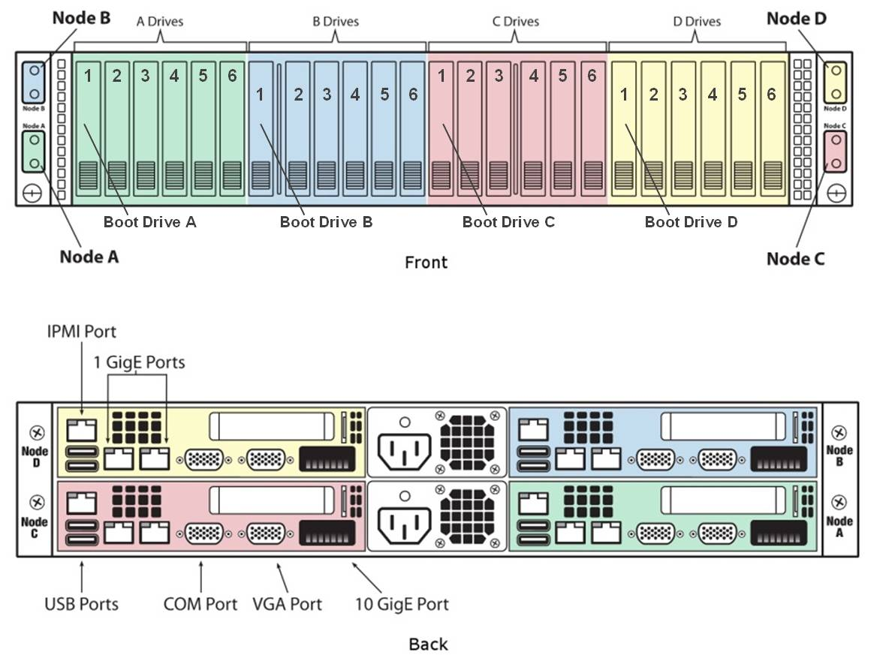
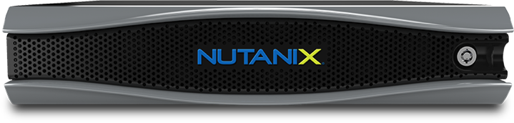
High Density Compute / Storage
4 Independent Compute/Storage Nodes
Storage
480GB – 3.84TB SSDs
1TB – 8TB HDDs
4 Nutanix virtualized storage controllers
Compute
1x 8 core CPU up to 2x 22 Core CPU (per node)
64GB RAM up to 1.5TB RAM (per node)
Dual 10GbE up to Quad 10GbE (per node)
4 Nodes in 2U

Slide 10
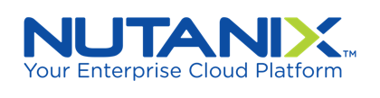












Powering All Workloads and Use Cases
DB
N
VM
Business
Critical Applications
VDI
Remote and
Branch Office
Messaging, Collaboration
and UC
Dev/Test
Big Data
Server
Virtualization
and Private Cloud
Notes:
Any app at any scale
There’s a lot of FUD from traditional infrastructure vendors that HCI is good only for VDI. Nothing could be farther from the truth
Businesses the world over run their mission-critical applications and production workloads on Nutanix. They use the Nutanix solution for running enterprise applications such as SQL Server and Oracle and SAP as well as for remote office/branch office deployments and for collaboration and unified communication
Many of our customers start with one or two use cases, and then expand into other applications as they get comfortable with the solution
Remember to:
Talk about different hardware models and the ability to mix and match different appliance types in a single cluster
Talk about software capabilities such as VM flash mode (VM pinning to flash) that are built for performance-sensitive workloads

Slide 11
Why Not AWS For All Workloads?
Elastic Workloads
25%
Spin up and down resources on the public cloud
Predictable Workloads
75%
Lower costs with private cloud infrastructure
Balance Owning and Renting For Today’s Enterprise Workloads
Notes:
Public clouds are great for applications and workloads that have unpredictable or variable demands. For example, if a business launches a new online/mobile app (e.g., new online shopping experience, checking scanning app from a bank), the demand for the app or service is not well understood initially. In this case, public cloud allows businesses to ramp up resources for the app depending on demand. However, as the demand for the app becomes more stable/predictable, it is more economical to deploy on prem. Another example is applications such as month-end payroll systems or online shopping portals that have highly variable/seasonal demands with peak demands that are several times the average. This is why when NASA kicked off the Mars Exploration Rover mission, the event telecast was done on the cloud because the demand was unpredictable and highly elastic (a one time event)
By not tying up idle infrastructure when not needed, businesses can save costs. But for more predictable or stable workloads, which is a majority of enterprise applications, public cloud services can be considerably more expensive than on-premises infrastructure
Businesses want to balance owning and renting, choosing between private and public infrastructure depending on application workload characteristics. There are situations where it makes sense to rent, and others where owning is better economically
If you’re going to a new city, e.g., Miami or New York and will be there for a week, you will look for a hotel or AirBnB. If you’re going to stay for 6 months, you’ll try to rent a place. But if you’re going to stay there for 3 years, it probably makes sense to buy a place and sell it later when you move

Slide 12
Choices Nutanix gives you
Choice of deployment method for software
  Appliance
  Software only

Slide 13
Choices Nutanix gives you
Hardware platform
  SuperMicro: Nutanix appliance version “NX systems”
  Dell: OEM agreement; systems are “XC systems”
  Lenovo: OEM agreement; systems are “HX systems”
  IBM: OEM agreement announced
  Cisco: “Meet in the channel” approach
  HPE: “Meet in the channel” approach

Slide 14
Choices Nutanix gives you
Hypervisor
  VMware ESXi
  Microsoft Hyper-V
  Citrix Xen server
  KVM
  Nutanix Acropolis Hypervisor (AHV)

Slide 15
Choices Nutanix gives you
Ways to acquire
  Purchase systems up front, and upgrade as needed, in the increments you determine
  Pay as you go (Nutanix Go)

Slide 16
Some additional points
Nutanix runs virtualized and now all workloads
All applications will run on HCI
Major vendors never rewrote their platforms, they just wanted to make sure they had a similar product
This technology is disruptive, so don’t expect your vendors or partners bring it up unless they have to
Your overall IT spend will go down
It’s cheaper than the Public Cloud

Slide 17
What’s coming next week?
  The next phase of Nutanix’s journey for their customers; true Enterprise Cloud

Slide 18
About Roundstone Solutions
Experienced IT Solutions Provider/VAR
Based in San Francisco, focused on Northern CA companies and organizations
Experienced with traditional 3-Tier Architectures, with Authorized Partnerships with most major IT vendors
Experienced with newer technologies that will make your infrastructure more effective, with Authorized Partnerships with IT vendors
Local experts in hyper-converged infrastructure and Nutanix
Prefer to meet face-to-face to learn about our Clients’ environments, rather than just communicating over email or the phone
We won’t waste your time or ours

Slide 19
What Roundstone does
Working with Vendor Partners, we help Clients design and architect Next Generation Datacenters and Networks
We supply technology solutions from major and emerging IT manufacturers
We provide Professional Services to support Clients
We arrange for Public Cloud provisioning for workloads as appropriate

Slide 20
Infrastructure Focus Areas
Hyper-Converged Infrastructure (HCI)
Hybrid and All Flash Array (AFA) Storage
Software Defined Storage
Unified Communications as a Service (UCaaS)
Next Generation Security approaches

